Slide 1

VSB Power Line Fault Detection
Using Machine Learning Classification Models to Detect Partial Discharge Faults in Covered Conductors in the Real Environment
Jeffrey Egan / February 2019
Notes:
Using Machine Learning Models to Complete OkCupid Demographics Data Sets: An Initial Investigation

Slide 2

First, what is Kaggle?
Kaggle is an online community of data scientists and machine learners.
Kaggle allows users to:
Find and publish data sets.
Explore and build models in a web-based data-science environment.
Work with other data scientists and machine learning engineers.
Enter competitions to solve data science challenges.
Kaggle got its start by offering machine learning competitions and now also offers a public data platform, a cloud-based workbench for data science, and short form Artificial Intelligence education.
Google acquired Kaggle on 8 March 2017.
Notes:
https://en.wikipedia.org/wiki/Kaggle
https://www.kaggle.com/

Slide 3
Challenge: Partial Discharge Fault Detection
Overhead power lines run for hundreds of miles to supply power to cities. These great distances make it expensive to manually inspect the lines for damage that doesn't immediately lead to a power outage (like tree branches falling on lines).
These modes of damage lead to a phenomenon known as partial discharge — an electrical discharge which does not bridge the electrodes between an insulation system completely.
Partial discharges slowly damage the power line, so left unrepaired they will eventually lead to a power outage or start a fire.
The challenge is to detect partial discharge patterns in signals acquired from these power lines with a new meter designed at the ENET Centre at VŠB. Effective classifiers using this data will make it possible to continuously monitor power lines for faults – helping to reduce maintenance costs and prevent power outages.
Notes:
https://www.kaggle.com/c/vsb-power-line-fault-detection
Medium voltage overhead power lines run for hundreds of miles to supply power to cities. These great distances make it expensive to manually inspect the lines for damage that doesn't immediately lead to a power outage, such as a tree branch hitting the line or a flaw in the insulator. These modes of damage lead to a phenomenon known as partial discharge — an electrical discharge which does not bridge the electrodes between an insulation system completely. Partial discharges slowly damage the power line, so left unrepaired they will eventually lead to a power outage or start a fire.
Your challenge is to detect partial discharge patterns in signals acquired from these power lines with a new meter designed at the ENET Centre at VŠB. Effective classifiers using this data will make it possible to continuously monitor power lines for faults.
ENET Centre researches and develops renewable energy resources with the goal of reducing or eliminating harmful environmental impacts. Their efforts focus on developing technology solutions around transportation and processing of energy raw materials.
By developing a solution to detect partial discharge you’ll help reduce maintenance costs, and prevent power outages.

Slide 4
Examination Reveals Highly Unbalanced Data
All Provided Data: Labeled & Unlabeled
Labeled Training Set: 2,904 Measurements = 8,712 Signals (only 30% of data is labeled)
Unlabeled Test Set: Perform Binary Classification: 6,779 Measurements = 20,337 Signals
Occurrence of Faults and Non-Faults in Labeled Data
8187 Signals without Fault, 213 Signals with Fault (only 2.5% of labeled signals have faults!)
Grouping of Signal Faults per Measurement
Measurements with no faults present: 2710 (93.3% of measurements exhibit no fault)
Measurements with fault present in only 1 phase: 19 (9.7% of cases where faults present)
Measurements with faults present in 2 of 3 phases: 19 (9.7% of cases where faults present)
Measurements with faults present in all 3 phases: 156 (80.4% of cases where faults present)
Notes:
Analogous to the scales of data they’re working with.
Incredibly unbalanced data set!
Also while submission requires a per-signal classification, it appears that faults present in signals are not entirely independent events (e.g. one faulty signal in a measurement has > 90% chance of having other faults.

Slide 5
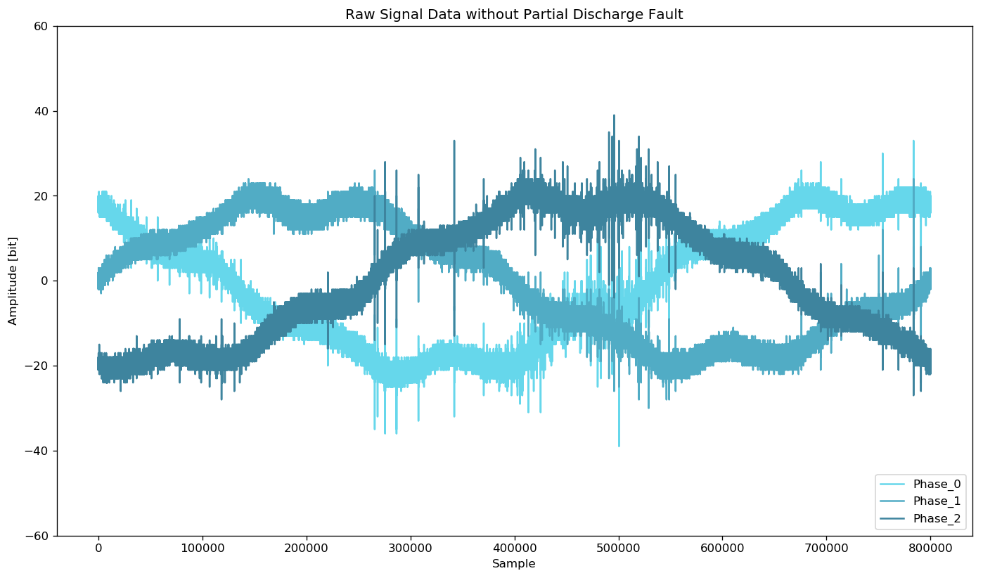
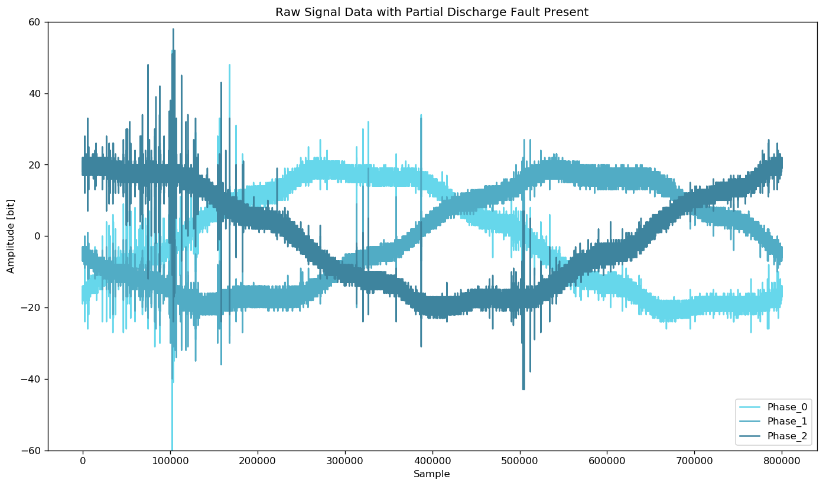
Sample Measurements with 3 Phase Signals
Each signal (phase) contains 800,000 measurements of a power line’s voltage, taken over 20 milliseconds.
For signal processing, that means each signal data set has a sample rate of 40 million samples per second.
The underlying electric grid operates at 50Hz, this means each signal covers a single complete grid cycle.

Slide 6
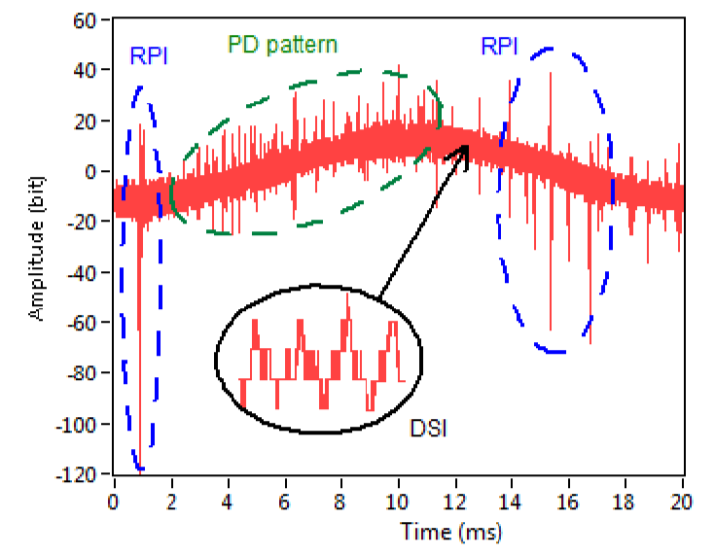
Detecting Partial Discharges is Difficult
PD Pattern Observed alongside other Noise Sources
Many other sources of noise could be falsely attributed to partial discharge.
Ambient and Amplifier Noise
PD: Partial Discharge Fault Pattern
DSI: Discrete Spectral Interference
E.g. Radio Emissions, Power Electronics
RPI: Random Pulses Interference
Lightning, Switching Operations, Carona
Figure from Reference [1]
Notes:
Misak, S., et al. “A Complex Classification Approach of Partial Discharges from Covered Conductors in Real Environment.” IEEE Transactions on Dielectrics and Electrical Insulation, vol. 24, no. 2, 2017, pp. 1097–1104., doi:10.1109/tdei.2017.006135.
The inherit difficulty with coding detection logic, makes this problem an excellent candidate for exploration and addressing with machine learning.

Slide 7
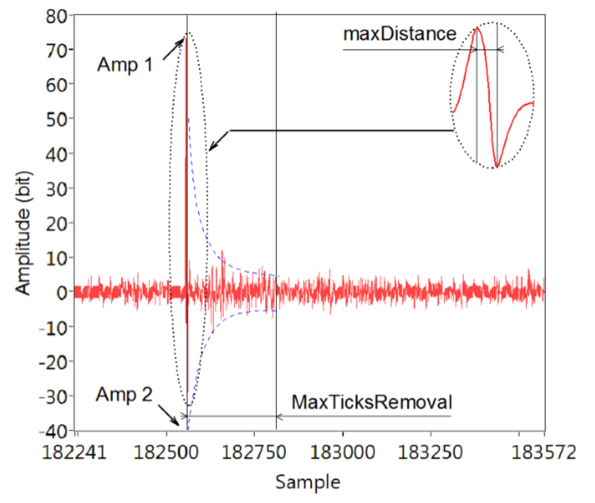
Identify and Cancel Carona Discharge Peaks
Carona Discharge Peak Detail
A corona discharge is an electrical discharge brought on by the ionization of a fluid such as air surrounding a conductor that is electrically charged.
Spontaneous corona discharges occur naturally in high-voltage systems unless care is taken to limit the electric field strength.
A corona will occur when the strength of the electric field (potential gradient) around a conductor is high enough to form a conductive region, but not high enough to cause electrical breakdown or arcing to nearby objects.
Figure from Reference [1]
Notes:
https://en.wikipedia.org/wiki/Corona_discharge

Slide 8
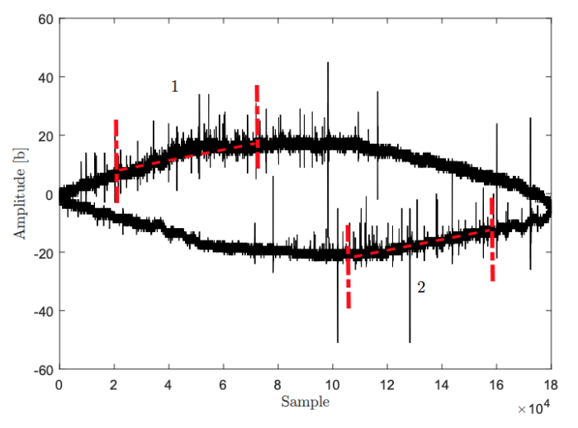
Focus on Portions of the Sinusoid with Rising Amplitude for Improved PD Detection
Sections of Sinusoidal Shape (1,2) with the Statistically Highest Occurrence of PD pulses
One of the most common fundamental features of the PD pattern is that it occurs on the rising amplitude edges of the sinusoidal curve.
For future iterations of feature extraction, this allows us to omit the rest of the signal.
This change should improve the efficiency of processing signal data as well improve the model’s ability to detect true faults and avoid false positives.
Figure from Reference [2]

Slide 9
Signal Processing Approach
Discrete Wavelet Transform to Remove Spectral Interference and Ambient Noise
Daubechies 4 Wavelet (db4)
Fit a Sinusoidal Function to the DWT Signal and Detect the PD-Probable Region
Use an Nth Discrete Difference to De-Trend the Function
Perform Peak Detection and Subsequently Cancel of False Peaks
Peak Detection using Fixed Amplitude Threshold
Cancel High Amplitude Peaks, and Peaks Attributed to Carona Discharge
Raw Signal
Fit Sinusoid & Detect PD-Probable Region
Nth Discrete Difference Detrending
Peak Detection
False Peak Cancellation
Extract Features
Discrete Wavelet Transform

Slide 10
Examining the Raw Signal Data

Slide 11
Examining the Raw Signal Data

Slide 12
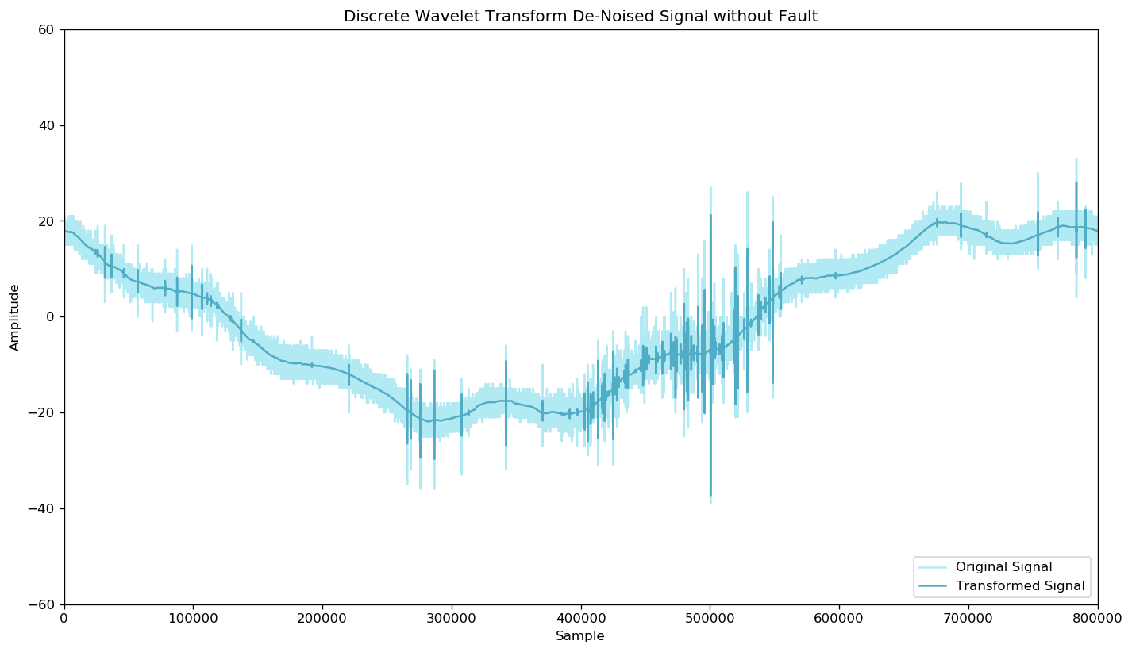
Remove DSI & Ambient Noise with DWT

Slide 13
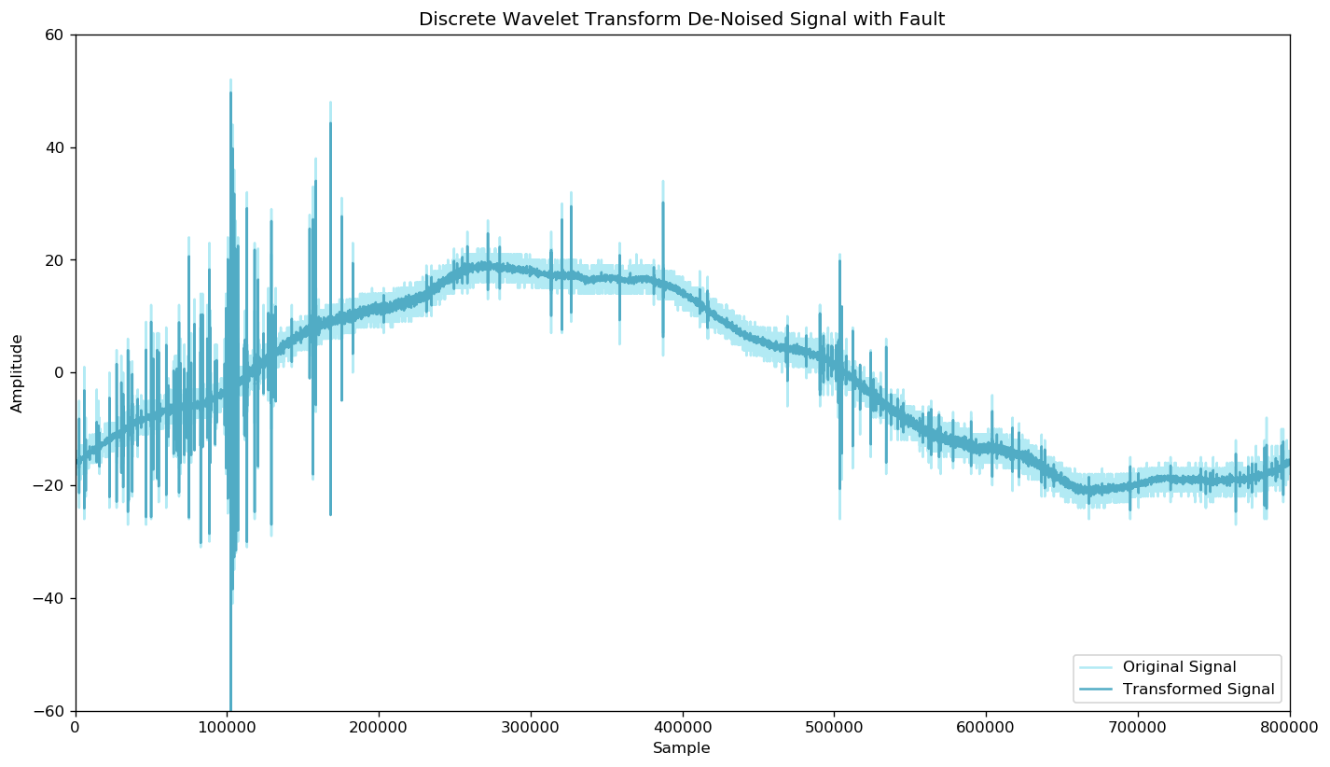
Remove DSI & Ambient Noise with DWT

Slide 14
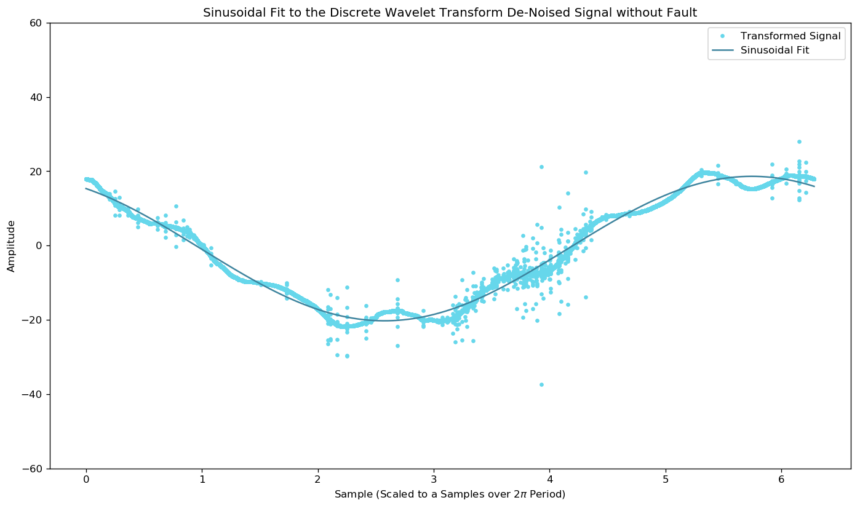
Fit a Sinusoidal Function to the DWT Signal

Slide 15
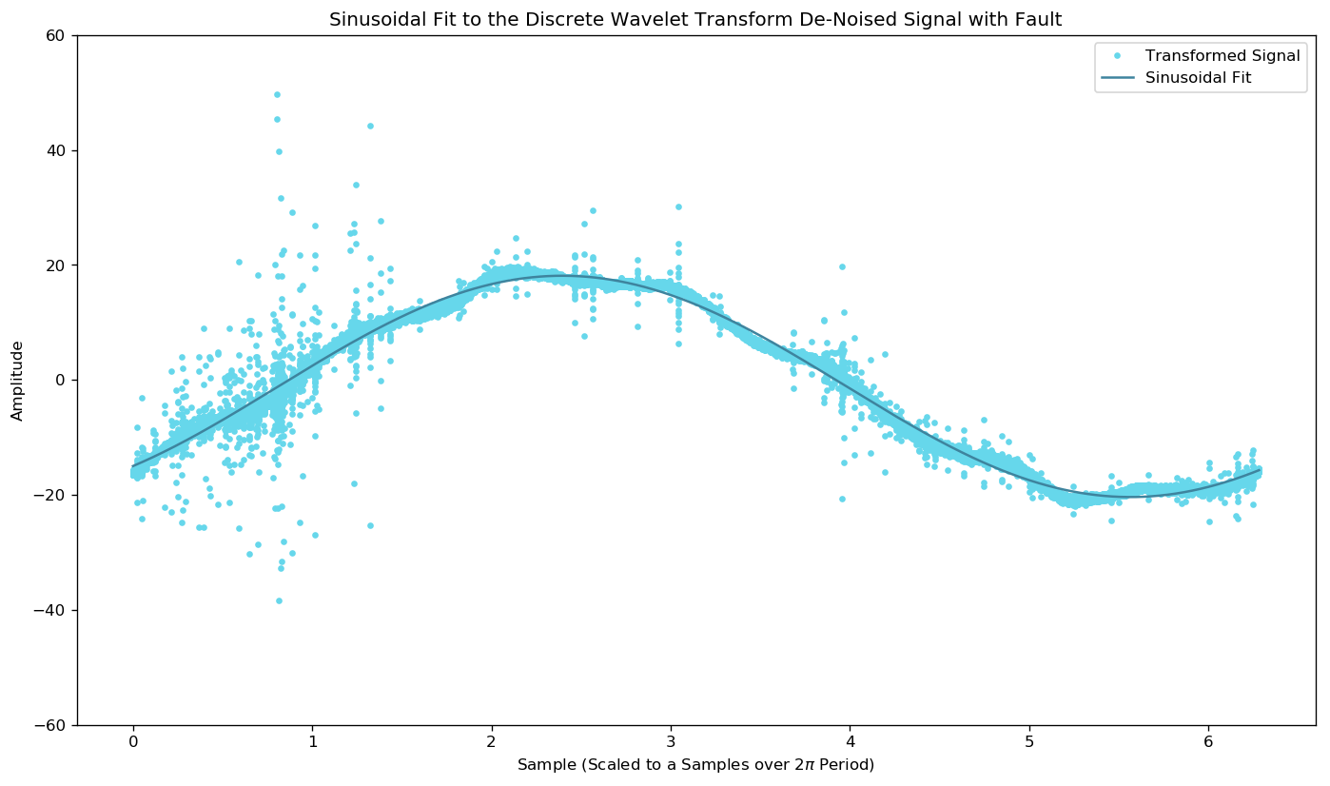
Fit a Sinusoidal Function to the DWT Signal

Slide 16
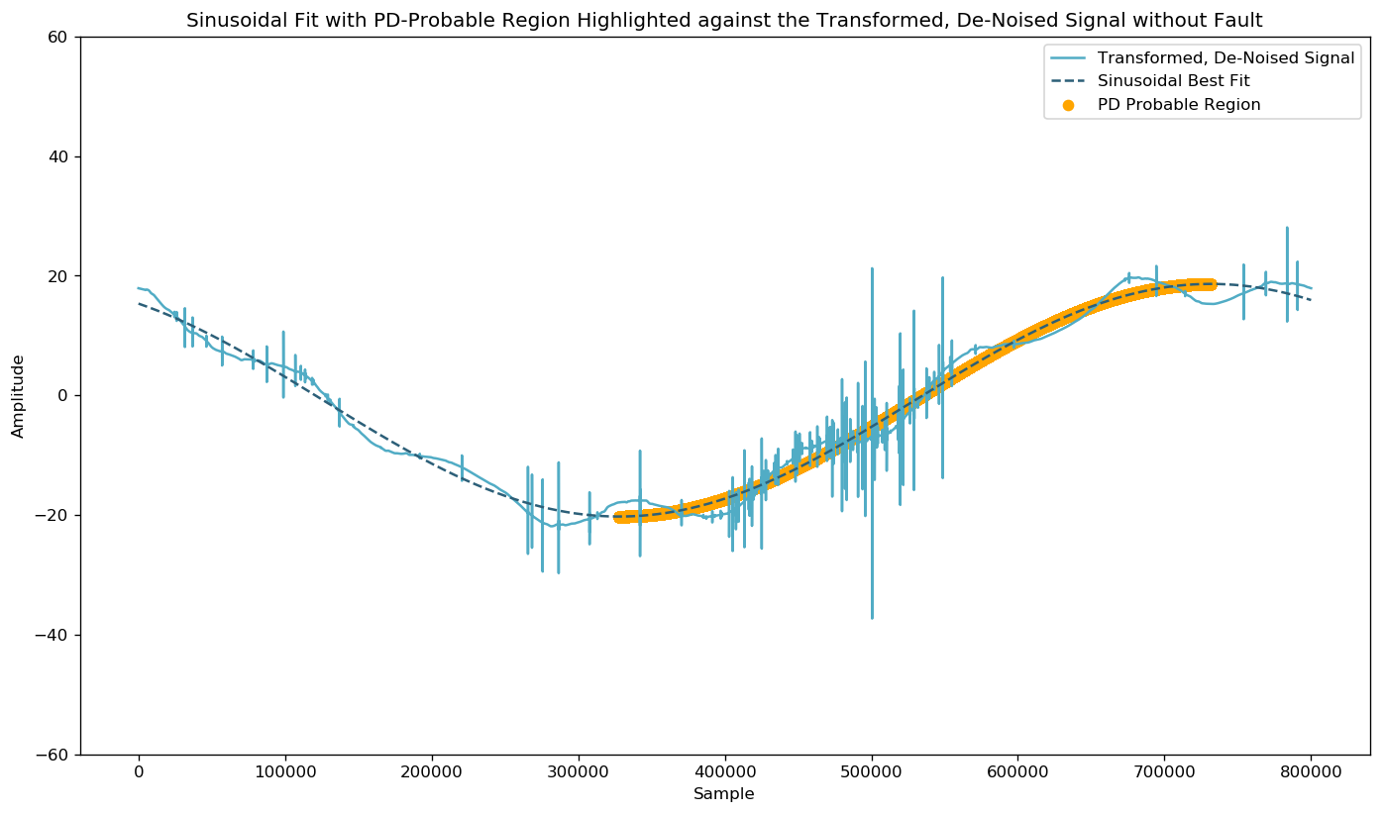
Use Sinusoid to Identify PD-Probable Region

Slide 17
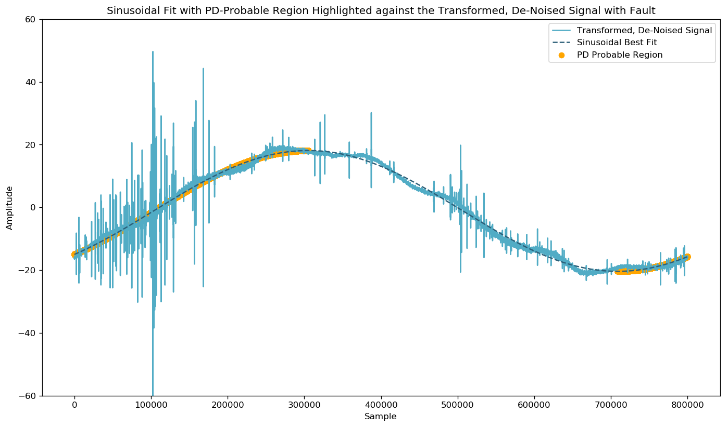
Use Sinusoid to Identify PD-Probable Region

Slide 18
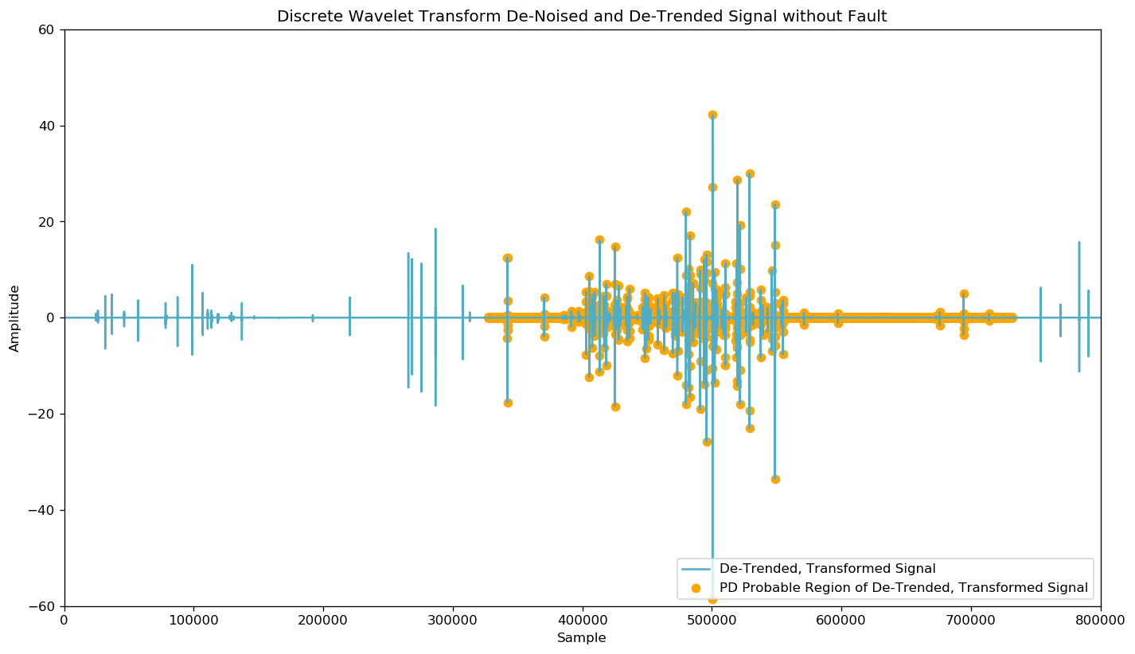
Detrend Signal to Remove Sinusoidal Element

Slide 19
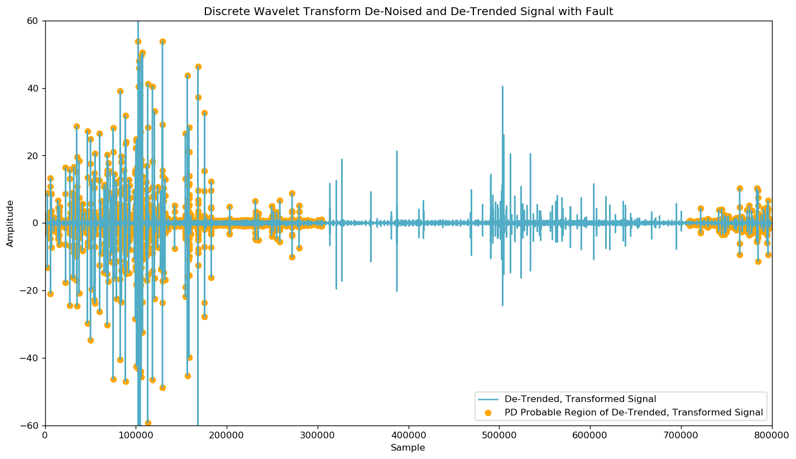
Detrend Signal to Remove Sinusoidal Element

Slide 20
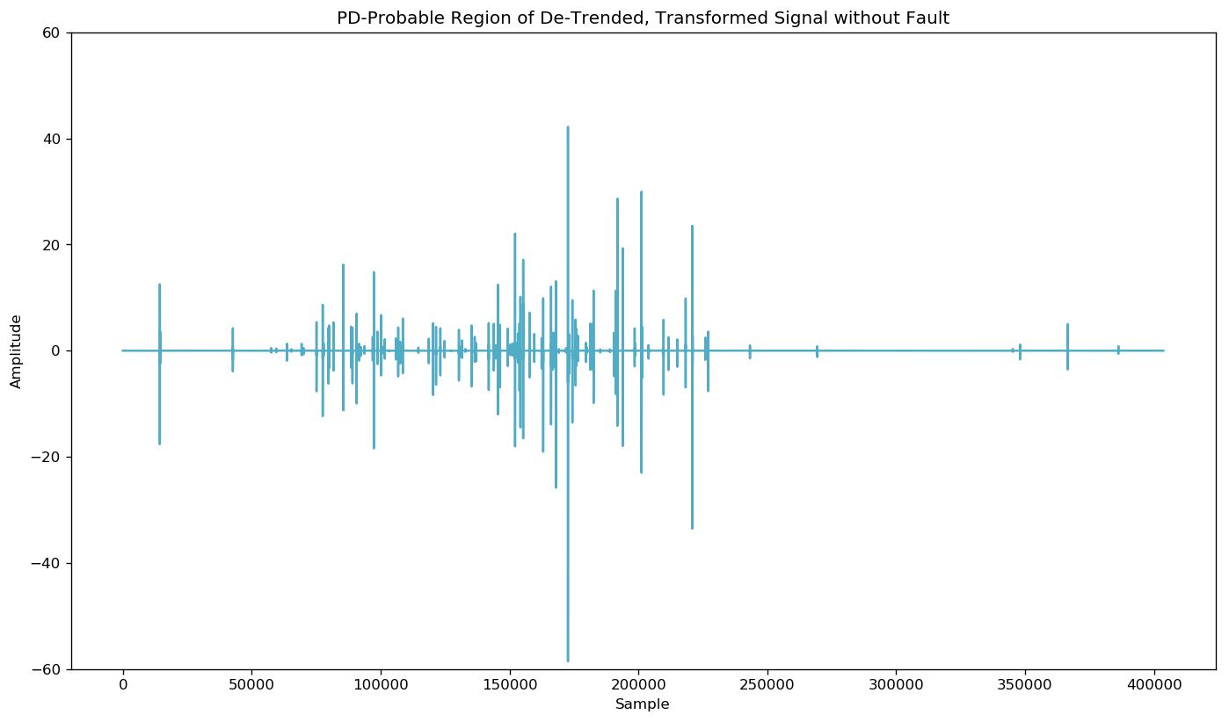
Trim to PD-Probable Region of Detrended Data

Slide 21
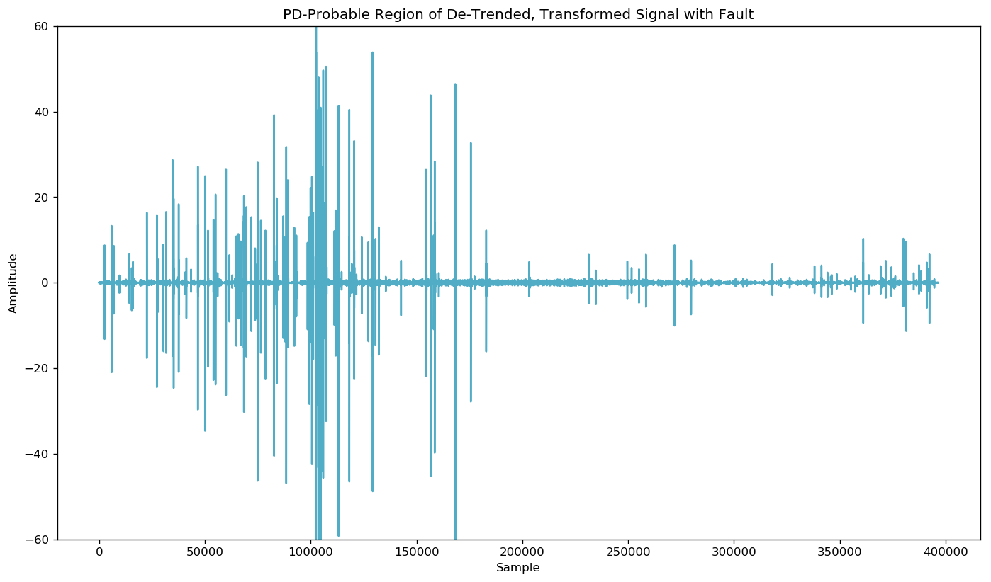
Trim to PD-Probable Region of Detrended Data

Slide 22
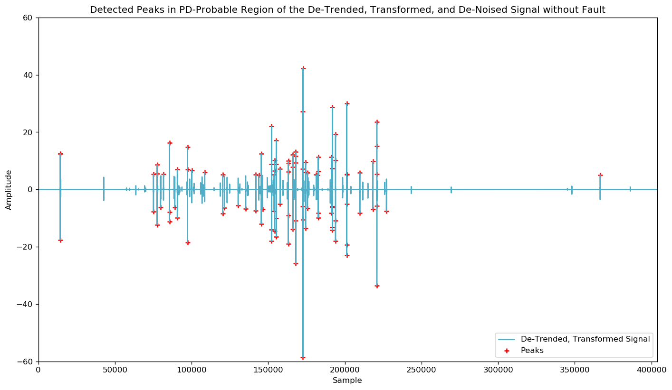
Run Peak Detection on PD-Probable Region

Slide 23
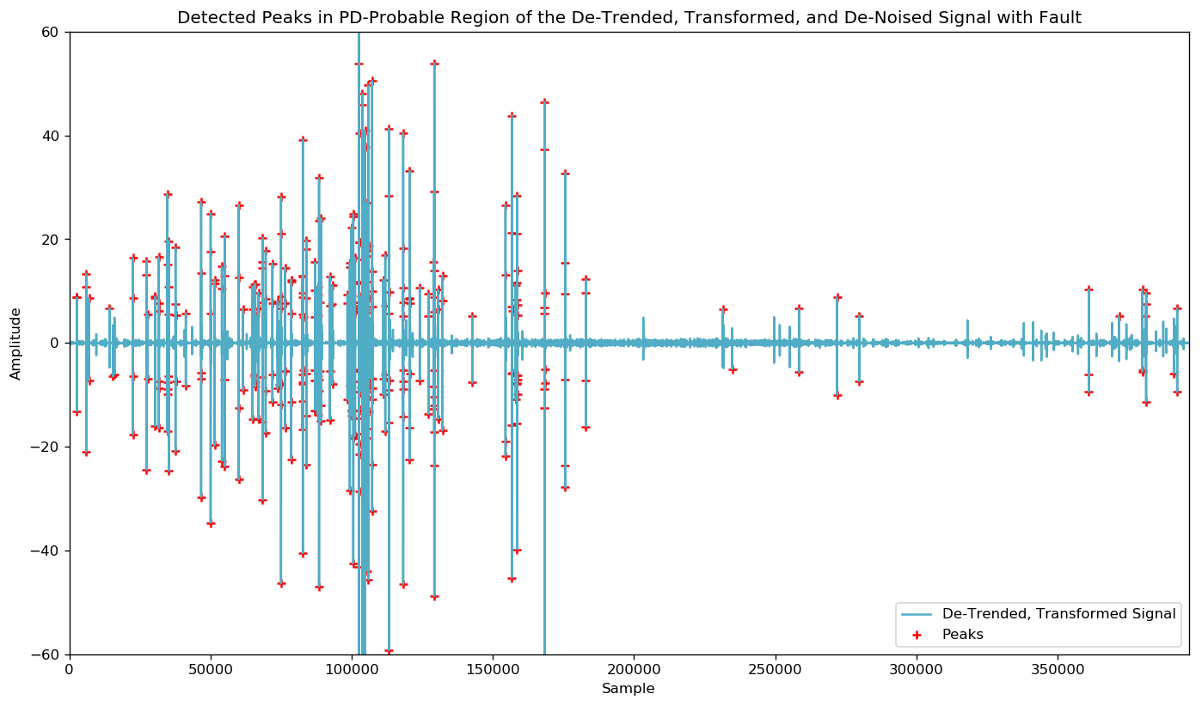
Run Peak Detection on PD-Probable Region

Slide 24
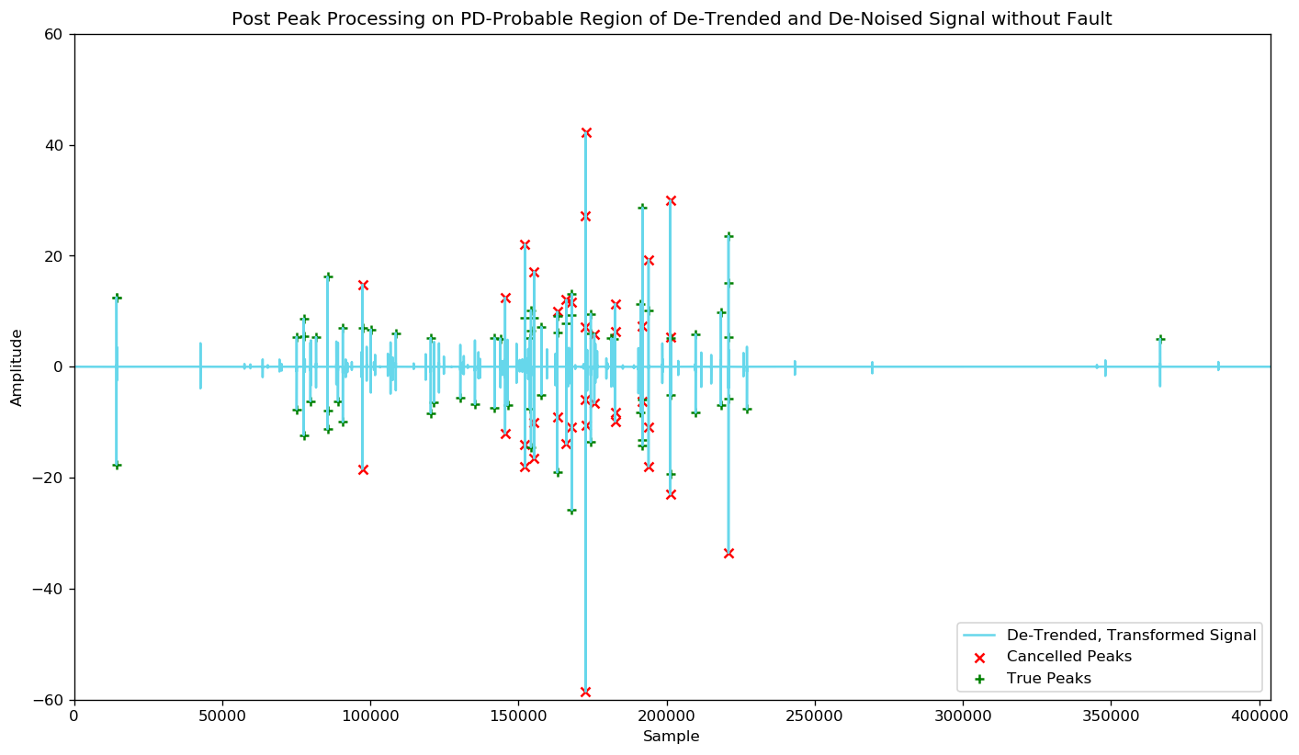
Cancel False Peaks Before Processing Signals

Slide 25
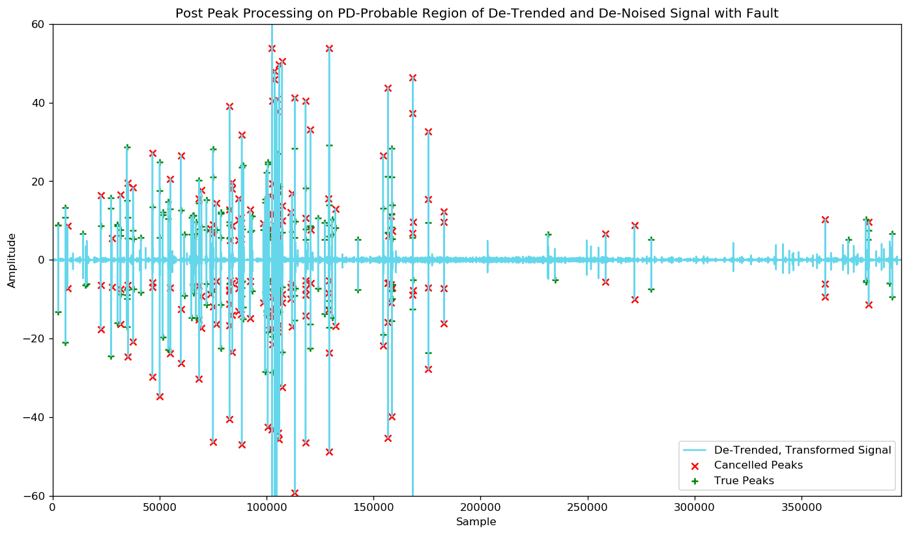
Cancel False Peaks Before Processing Signals

Slide 26
Perform Feature Extraction on Signal
Process the PD-Probable Region of the De-Trended, De-Noised Signal and Build a Feature Table to be used as Input to Machine Learning Models.
5th Percentile
25th Percentile
75th Percentile
95th Percentile
Median
Mean
Standard Deviation
Variance
Root Mean Square
Entropy
Number of Zero Crossings
Number of Mean Crossings
Minimum Peak Height
Maximum Peak Height
Minimum Peak Width
Maximum Peak Width
Number of Detected Peaks
Number of True Peaks

Slide 27
Feature Data Exploration
To Do
Add Once Extraction Complete

Slide 28
Prototype Binary Classification Models
At the root of the task is building a Machine Learning model capable of binary classification and this also equally adept at handling unbalanced classes.
k-Nearest Neighbors (k-NN)
Simple implementation and quick execution
Support Vector Machines (SVM)
Simple implementation and quick execution
Random Forest Decision Trees (RF)
Fairly simple implementation, regarded for handling unbalanced data
Light Gradient Boosting Framework (LightGBM)
Complex tuning options, distributed, and highly regarded for handling unbalanced data
In the binary classification case, returns the probability that a sample belongs to the positive class.

Slide 29
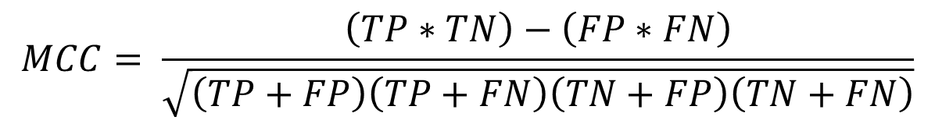
Evaluate Model Performance with MCC
Submissions are evaluated using Matthews Correlation Coefficient (MCC) between the predicted and observed response. The MCC is given by: where TP is the number of true positives, TN the number of true negatives, FP the number of false positives, and FN the number of false negatives.
Matthews Correlation Coefficient is an apt metric to assess a binary classification model, especially one with a highly unbalanced class where metrics like accuracy, precision, and recall don’t adequately capture the effectiveness of a model.
$$MCC= \frac{\left(TP∗TN\right)−\left(FP∗FN\right)}{\sqrt{\left(TP+FP\right)\left(TP+FN\right)\left(TN+FP\right)\left(TN+FN\right)}}$$
Notes:
https://en.wikipedia.org/wiki/Matthews_correlation_coefficient
Can’t use accuracy… if the training data is representative of the larger data population (which you hope it would be), you’d be correct in labeling a sample without fault ~98% of the time. These metrics don’t capture what we’re trying to accomplish in this competition.
MCC is also the metric employed by the competition organizers.

Slide 30
Preliminary Results
To Do
Add Once Extraction Complete
Train and Run Models in Notebook

Slide 31
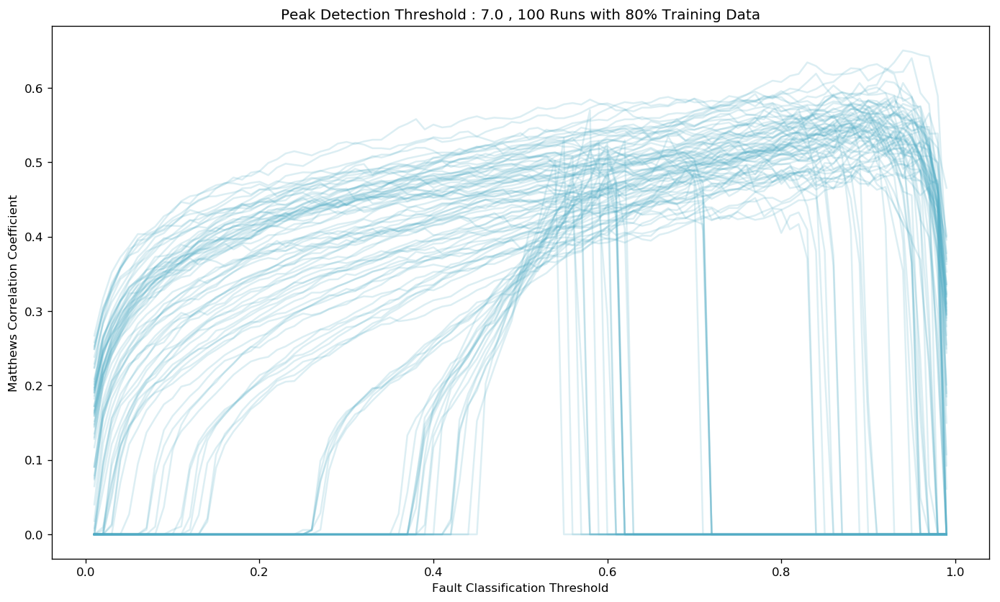
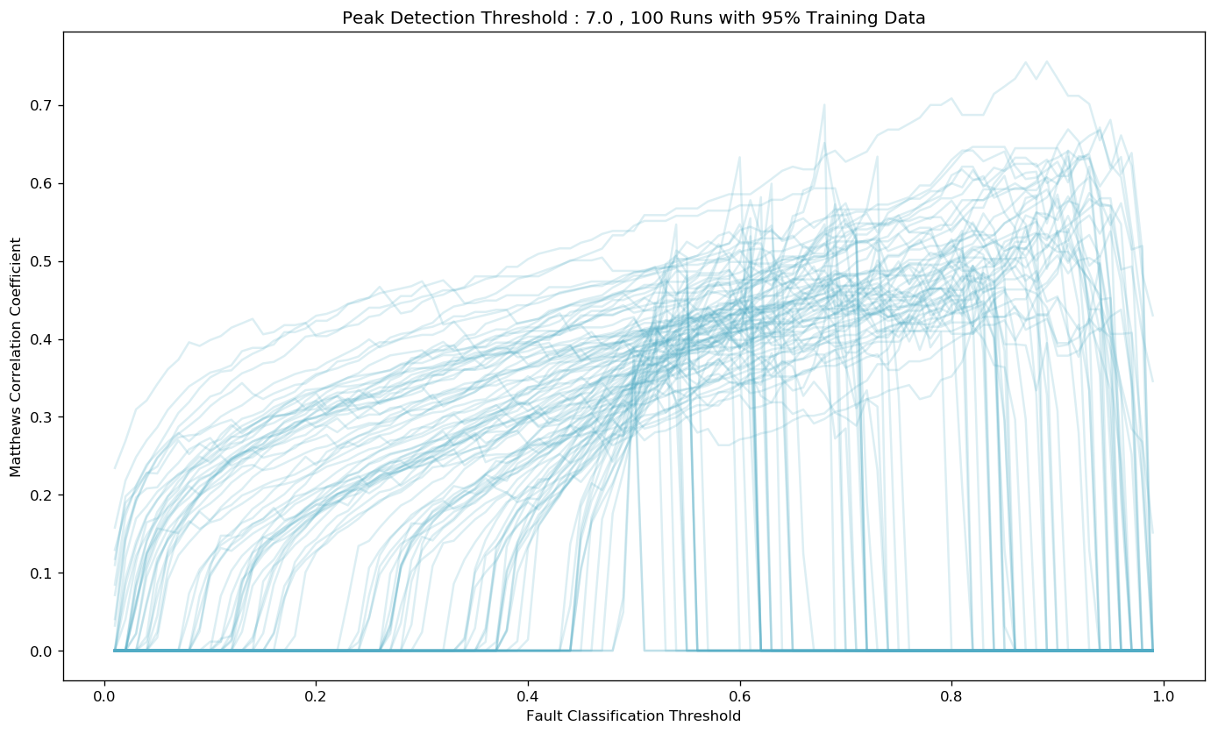
Use Monte Carlo Analysis to Set Thresholds
Perform Monte Carlo trials that vary the random_state and test_size parameters in sklearn’s train_test_split function and assess the impact of different thresholds on performance.
The goal is to find and set thresholds for Peak Detection and Fault Classification that routinely yield higher Matthews Correlation Coefficient scores and are robust to varied divisions of the training data.
Notes:
Initial submissions proved less than spectacular, my localized training used a fixed random_state (my usual preference for repeatability) that happened to put me at the high end of these types of plots.
I has also used a standard 80-20 split, …
Goal here was to find some thresholds (both for peak detection and fault classification) that routinely yielded greater MCC scores and that was robust to varied splitting of the training data.

Slide 32
Tuning LightGBM for Unbalanced Data
To Do
LGBM Params

Slide 33
Project Results
Kaggle Leaderboard
To Do
Kaggle Leaderboard Results

Slide 34
Conclusions
Increased experience with performing signal processing in Python
Increased experience with binary classification machine learning tasks where the labeled data is heavily unbalanced
Introduction and familiarity with a new (to me) machine learning framework: LightGBM
At the conclusion of competition, my Kaggle kernel and GitHub repos went public:
Kaggle Kernel: https://www.kaggle.com/jeffreyegan/
GitHub Repo: https://github.com/jeffreyegan/VSB_Power_Line_Fault_Detection
Forks welcome!
Notes:
Update Kaggle link, and top conclusions

Slide 35
Improvements
While not uniformly true, when a fault is present in one phase, the likelihood of fault present in one or both or the other phases is also quite high.
Implement some logic that weights the probability of detection in the aggregate of the measurement?
How to use this data without introducing bias?
At the conclusion of competition, my Kaggle kernel and GitHub repos went public:
Kaggle Kernel: https://www.kaggle.com/jeffreyegan/
GitHub Repo: https://github.com/jeffreyegan/VSB_Power_Line_Fault_Detection
Forks welcome!
Notes:
Also while submission requires a per-signal classification, it appears that faults present in signals are not entirely independent events (e.g. one faulty signal in a measurement has > 90% chance of having other faults.

Slide 36
References
Misak, S., et al. “A Complex Classification Approach of Partial Discharges from Covered Conductors in Real Environment.” IEEE Transactions on Dielectrics and Electrical Insulation, vol. 24, no. 2, 2017, pp. 1097–1104., doi:10.1109/tdei.2017.006135.
Vantuch, Tomas. Analysis of Time Series Data, 2018, dspace.vsb.cz/bitstream/handle/10084/133114/VAN431_FEI_P1807_1801V001_2018.pdf.

Slide 37

What’s Next?
Predicting Earthquakes for Los Alamos National Labs – Geophysics Group!
Forecasting earthquakes is one of the most important problems in Earth science because of their devastating consequences. Current scientific studies related to earthquake forecasting focus on three key points: when the event will occur, where it will occur, and how large it will be.
In this competition, you will address when the earthquake will take place. Specifically, you’ll predict the time remaining before laboratory earthquakes occur from real-time seismic data.
https://www.kaggle.com/c/LANL-Earthquake-Prediction

